Slide 1
Flood Monitoring and Early Warning system:
Introduction:
Floods are among the most common and damaging disaster types in the world and affect the lives of millions of people worldwide annually. Floods and excessive rainfall are inevitable phenomena that can lead to massive loss of lives and infrastructure destruction. In Malaysia, flash flooding is a regular natural disaster that occurs during the monsoon season almost every year. The Department of Irrigation and Drainage (DID), Malaysia has categorized floods into two categories that are flash floods and monsoon floods. The difference between flash floods and monsoon floods were based on the time taken by the flow of the river to return to its normal position. Flash floods suddenly occur without a warning that surprises people in their everyday lives. Monsoon floods caused by the winds of the Northeast Monsoon occur between the months from November to March and the winds of the Southwest Monsoon from May to September.
The floods in December 2006 and January 2007 are also classified as the most damaging flood in Malaysia's history. The water level recorded during the floods reached 2,75 meters, the highest level since 1950. The mortality rate was 18, with more than 100,000 people evacuated during the disaster. Many factors that might be taken from the above cases, such as problems with drainage systems, dam breaks, urbanization and environmental management, weather and pollution, but the one that will be highlighted in this paper is the problem of the early flood monitoring system

Slide 2
The cost of flood damage is closely related to the warning time given before the occurrence of flood and this makes flood monitoring critical in reducing the cost of damages. Based on Sukeri Khalid et al, most of the people are agreed that the early warning system at Sultan Abu Bakar dam are not working in a good condition which caused a flash flood and about four people die and other property damages. Hence, this shows that early flood monitoring is very important in Malaysia to avoid more victims and flood damages to occur. Based on Mary Anne M. Sahagun et al, the importance of further studies in determining the water level in high-risk areas is consistent to warn the public about the potential rise in flood water level. In Malaysia, most flood cases rise more quickly and people have less time to evacuate and save their life and belongings. This is because some early flood alert systems are usually intended for the respective organizations and authorities.
One of the factors that contribute to the damages and loss of life when the flood occurs is poor flood monitoring system at a high prone area to flood. Poor flood monitoring can cause a disastrous effect to human and environment. Besides, victim cannot get accurate information on the current status and conditions before flood occurs in a short period of time. Accurate data need to be received by the victim quickly as the water level of flood rises rapidly. Lastly, a poor warning system of flood will lead to damages of livelihood and infrastructures.

Slide 3
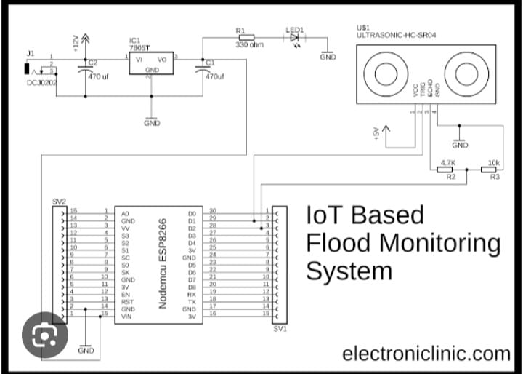
Circuit Diagram of Flood Monitoring and Early Warning System:

Slide 4
Research Method:
In this study, flood monitoring system using wireless sensor node is developed to observe the status of flood
which could alert people who were in the area frequently affected by floods in Selangor state, Malaysia. The system
consists of a sensor node which detects the water level and rain intensity using an Ultrasonic Distance Sensor (HC-
SR04) and rain sensor respectively. When the water level and rain intensity reaches a certain level of hazards, the
device will generate an alarm system with three different colours of LEDs indicating three levels of detection for flood
level in order to notify people on incoming flood in that area that could endanger their life
Numerous types of ultrasonic sensors with significant differences in frequency and power consumption are available. The high-frequency ultrasonic sensors will have a sharper beam width and may detect obstacles in a longer range. Some of the new sensors also have the same detection range as previous models but less power consumption. The ultrasonic sensors must be able to detect obstacles or objects between 2cm and 50cm in this project. Since the entire system supply is taken out of the supply, less current consumption is crucial and must be capable of operating at low voltage. HC-SR04 meets this project's criteria for detecting the level of flood water after long research between the HC-SR04 and other ultrasonic sensors.

Slide 5
NodeMCU based technology that acts as the microcontroller of this system that attached with ultrasonic and rain
sensors to form a wireless sensor node and placed at a high prone area of flood. When the sensors were triggered, all
the data will be sent to Blynk application to be viewed on user’s smartphone via the wireless connection. The integrated IoT architecture with Blynk application as it. At the same time, the data is stored in a CSV
database. This data can be converted into excel form through email which could alert the local authority for further
action once the level reached warning and critical level.
Two sensors are used as inputs to the NodeMCU and power supply of 5V is used to power up the system to
function well. The ultrasonic distance sensor is used to detect the flood level at a high prone area of flood (maximum is 3m away from it). In this project, 40cm of distance from the ultrasonic sensors and the water level will trigger the buzzer and LED. The rain module sensor detects the rain intensity and develops a notification alert when raining heavily started. The scope of this project is focusing at a high prone area of flood in Selangor. The Blynk application provides an interactive and easy to access platform for user or victim to get accurate information on the incoming floods by current condition of flood water level and rain intensity in real-time condition

Slide 6
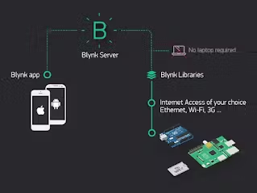
Blynk IoT-cloud Based Architecture

Slide 7
When there are changes in flood level, the graphs captured the data and change the measurements accordingly.
So, when there is immediate change in the measurement, the buzzer and LEDs will turn on which act as alerting
purposes. Blynk’s alert notification also sent to the victims when the flood water level or rain intensity reached a certain point of hazard. From, the flow chart explained the overall system and how it works. First, NodeMCU connected with the internet via Wifi connection. After the Blynk connection is established, ultrasonic sensors and rain sensor act as two different input of the system. When the water level rises, the system will continue to the next steps. Three processes when water level rises which are greater than 20%, greater than 40% and greater than 60% which trigger green, yellow and red LEDs respectively. Buzzer triggered with different frequency for every different process before sending the data to Blynk application. Besides, when the rain intensity rises, two processes occur which are greater than 60% and between 30% to 60%. All of these data are sent to Blynk application on user’s smartphone. Finally, notifications via Blynk and email are sent to the user for alerting purposes.

Slide 8
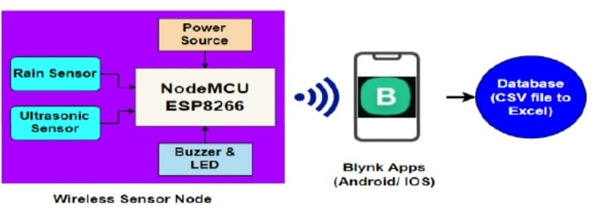
Schematic Diagram of the Proposed Flood Warning and Monitoring System

Slide 9
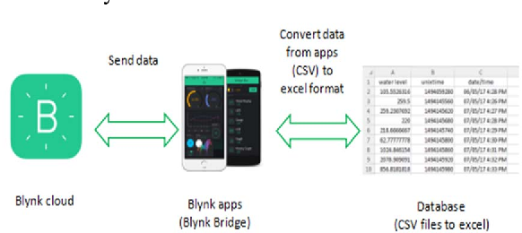
Blynk was designed to remotely controlled hardware where data can be displayed, data stored and data monitored. The Blynk platform consists of three main stages which are Blynk cloud, Blynk apps, and Blynk database.

Slide 10
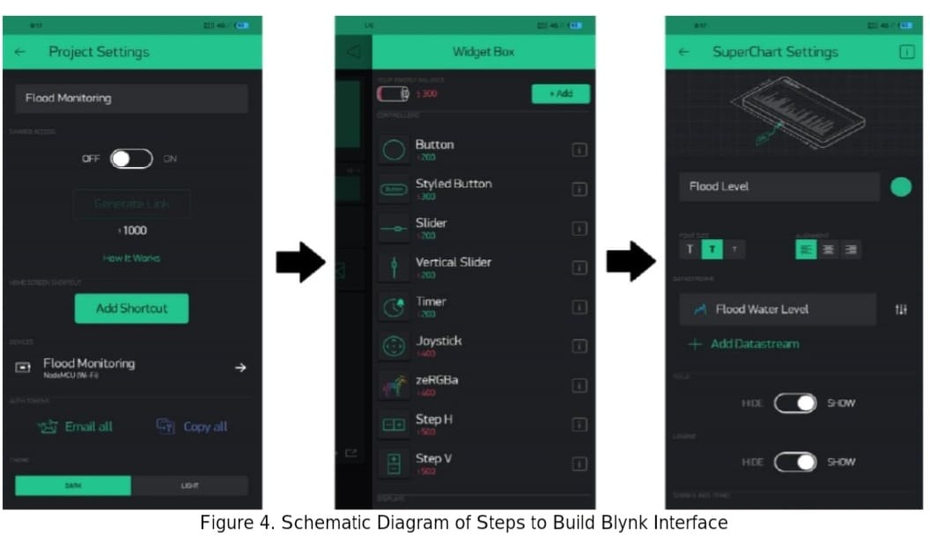
In this work, Blynk was used to create a flood monitoring system application for monitoring data from NodeMCU
which connected with ultrasonic and rain sensors over the internet by using a smartphone. There will be LCD to display the level indicator (safety, warning and critical level) inside the Blynk’s interface. Next, the value display widget will display the flood’s level sense by ultrasonic sensors. Besides that, different LEDs light up according to the current level to indicate the current status of flood. Lastly, the history graph widget could track the flood’s level and save it into the database.

Slide 11
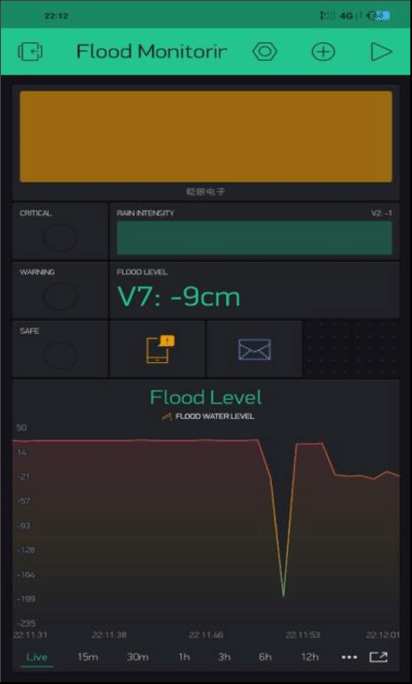
Completed System Blynk’s Interface

Slide 12
It shows the complete setup of Flood Monitoring System via Blynk application. An LCD display indicates flood detection on water level status which appear whether Safety level, Warning level or Critical level. Next, three LEDs that act as an indicator are displayed which triggered based on flood level status. Rain intensity level widget is added to display the rain intensity which acted as the first system’s monitoring on rain before huge flood occurs. A flood level is displayed in cm unit and the system sends the alert notification and email to the victim continuously when the flood water level together with rain intensity reached certain level of hazard. For the user or victim that always used social media, this system was very useful as it can send the alert via Twitter so they will keep updating with the latest condition of flood at their place. At the lowest part of the interface shows a Super-chart widget which could display the graph of flood level in real time condition. All the widgets kept updating between each other that lead to the combination of very useful system to warn and monitor current flood condition at place with high prone of flood in Selangor State.

Slide 13
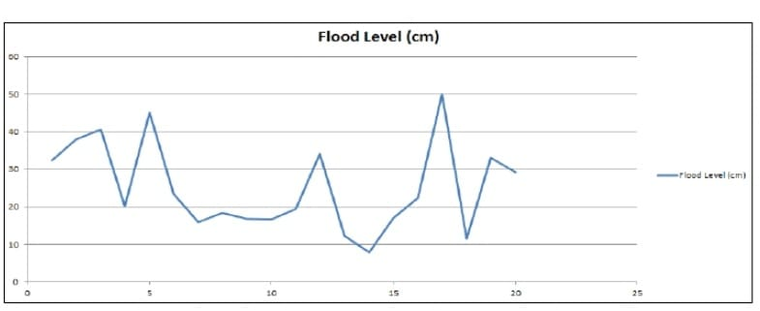
Results and Discussion:
To test whether the prototype works accordingly, an experiment was conducted to test the measurement of water detected by wireless sensor node. Buzzer and LED started to trigger when the water level reached 10cm until it reach critical level (30cm) away from the ground, a notification sent to victim through Blynk and email. Rain sensor detects the rain intensity and sends an alert when rain heavily started. Based on flood level detected,it can be viewed in the database that was sent to the email. The below graph shows the flood level for every minute. The x-axis is corresponding to the time, while y-axis is corresponding to the flood level monitoring. Whereas, it shows the Flood level on Blynk application that can be viewed on the user’s smartphone. In this information, x-axis represents for time, and y-axis represents for flood level. It provides an easy access for the user to get an accurate reading on flood level in real time condition. The graph shows the flood level reading for every second.
Schematic Diagram of steps to Build Blynk Interface

Slide 14
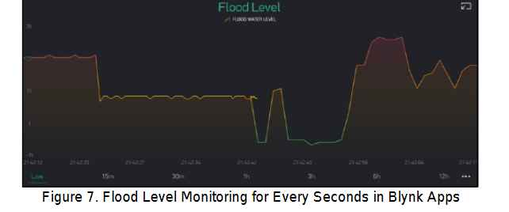
The below diagram shows the reading of data sense from the ultrasonic sensors from the system in Blynk application. There are three mode displays on the screen of the smartphone. It displayed level of water either in safety, warning or critical level to alert victims in a high prone area of flood. The distance of the water is also displayed on the widgets which used LED as the indicator (green for safety, yellow for warning, and red for critical). This history graph can be used to track the flood level in real time condition. There will be 3 states which are level 1, level 2, and level 3 to give alarm to the people. The data sensed by the sensor was displayed on the Blynk’s interface reflecting the level indicator as well as the distance.
Once the data being received, green LED and buzzer started to trigger when level 1 of flood level detected. Then, level 2 yellow LED will blink and buzzer triggered and lastly, at level 3 red LED turn on, as well as the buzzer. Once the water level reached 31cm, the system will send the alert notification to the user via email and Blynk push notification. Table 1 tabulates the range of level indicator that indicates the distance of sensor for safety purposes.

Slide 15
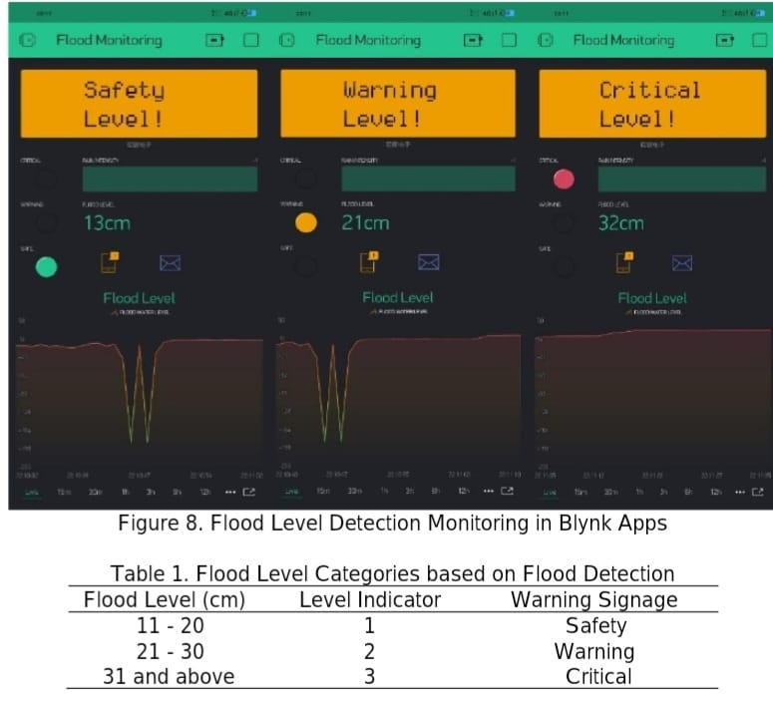

Slide 16
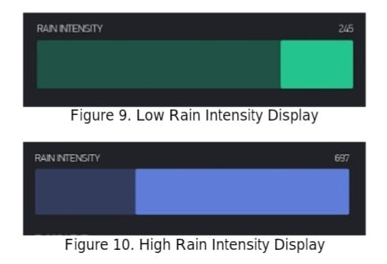
Rain Sensor Data on Blynk’s Interface:
It shows the condition when the rain started to fall at the particular place. The level of rain intensity which is in green colour shows that the rain just started to fall. This indicates that the people who live nearby should alert as they know their place will get a very disastrous disaster if the rain started heavily. “Rain Warning!!” notification is sent to the user for alerting purposes.
The rain intensity have reach a certain point that need to be consider by the victim who tend to face flood at their area. This is because, when the rain started to fall heavily, a higher tendency that a flood will occur at any time at that place. The system sends the notification “Raining Heavilly, Please be Aware!!” as an alert purpose so that the victim will get notified at any times and anywhere when the rain started to fall heavily.

Slide 17
The below diagram shows the notifications sent to the victim’s email regarding the water level which has reached a critical level. Therefore, victims will get to know the status of flood level precisely. shows the side view of the prototype. From the above figure, a black box is used to place the microcontroller of the system which is NodeMCU integrated with sensors. An external 5V of power supply is used to power on the system. shows an ultrasonic sensors is placed 50cm from the ground to detect the flood level in centimetre. shows the top view of the prototype. From the above figure, rain sensor module is placed at the top of the system. This is because the rain sensor will detect the rain intensity that fall on it. Besides, three different LEDs are used to indicate the different of flood levels warning signage. A buzzer which is placed near the LEDs will trigger with different frequencies based on multiple warning signage and colours of LEDs
The below diagram shows the PC and smartphone for monitoring purposes. Users could get the data of the flood water level from ultrasonic sensors for every minute via email. Then, users could monitor the Blynk interface which is designed for monitoring purposes. A graph plotted the flood level in centimeter in Excel format. The data plotted are important for future work of the system especially in flood forecasting and other improvement of the system

Slide 18
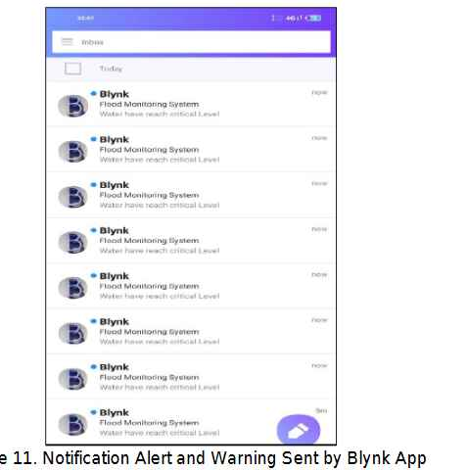

Slide 19
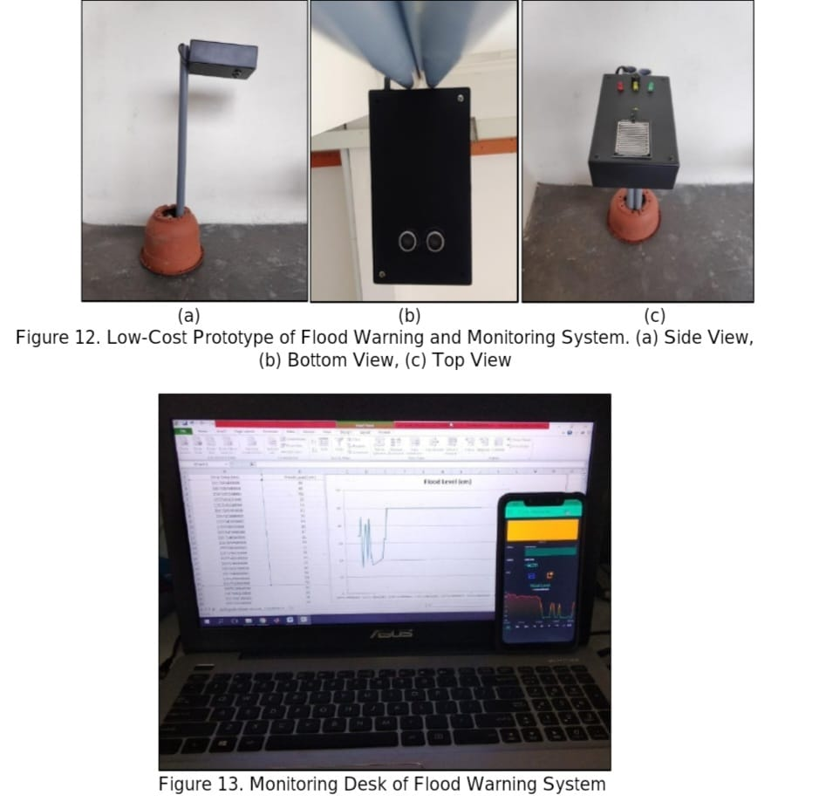

Slide 20
Conclusion:
This study based on the development of a smart flood monitoring system using ultrasonic sensors with NodeMCU and Blynk application. The results offer flexibility, efficiency and low cost. Wireless sensor node based on Blynk platform is an ideal platform to monitor flash floods and also as early warnings. The working of a low-cost ultrasonic sensors and rain sensor integrated with NodeMCU are able to detect and provide efficient and accurate sensing data for monitoring and alerting purposes. Through the experiment conducted, it shows that this system can be used for detecting, monitoring and alerting the community in Selangor in case of flash flood.
In this study, the prototype is only uses a small scale of sensor detection within 50cm. In actual world, the system
needs to detect the flood for about 1 to 2 meter if the system is placed at the riverside to detect flood. Besides, this prototype needs to be improved on the water resistant features so that when the rain started to fall, it cannot damage the sensor node. A proper installation need to be done so that the system can be put at any kind of surfaces to avoid it being fall down when water level rise up. Therefore, the system could help a huge number of victim’s life whenever the future work could be done on it.

